Slide 1
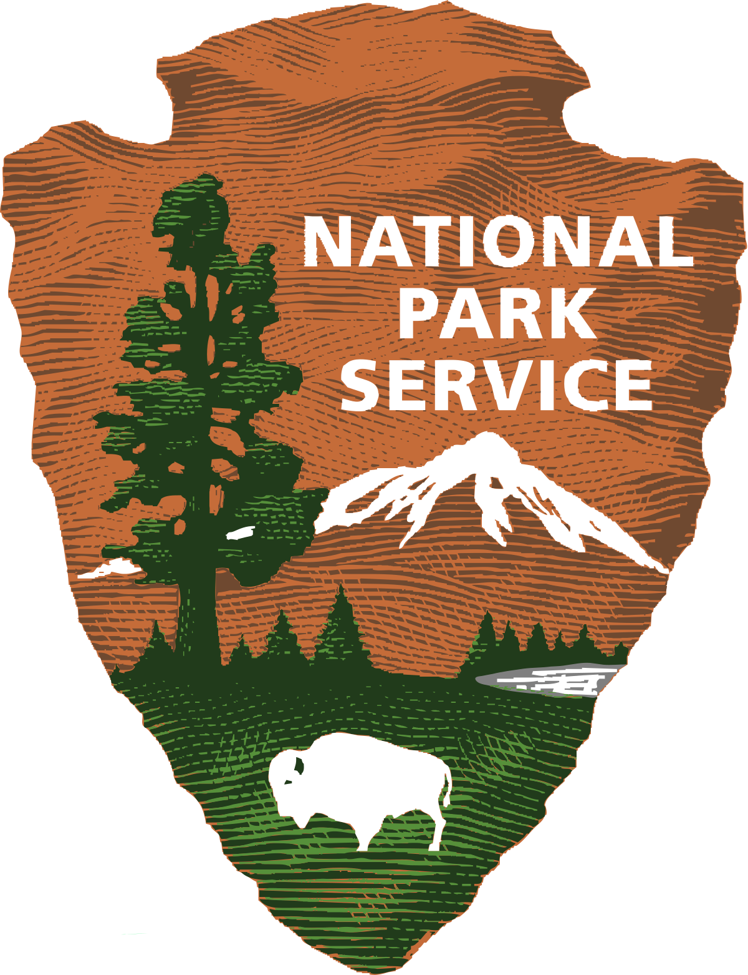
U.S. National Parks
Brendan Legas
Henry Byoun
Brandon Daniels
Grant Pittman
Jennifer Trevino

Slide 2
Disclaimer
The opinions or assertions contained herein are the private views of the author and not to be construed as official.

Slide 3
Objectives
Explore U.S. National Parks visitation and growth overtime.
Determine economic trends related to National Park visitation.
Describe correlations between social media engagement related to national parks.

Slide 4
Hypothesis
National parks visitation and popularity has increased in recent years.
Social media has influenced and mirrors park visitation popularity.
Rising trends of park visitation has influenced outdoor recreational business.

Slide 5
Data Sources
Search criteria:
All U.S. National Parks
REI yearly reports and financial statements
Social media related to National Parks
APIs
Twitter
Data pulls
National Park Services Visitor Use Statistics https://irma.nps.gov/STATS/Reports/Home
REI membership and financial data: https://www.rei.com/about-rei/financial-information; https://www.rei.com/stewardship

Slide 6
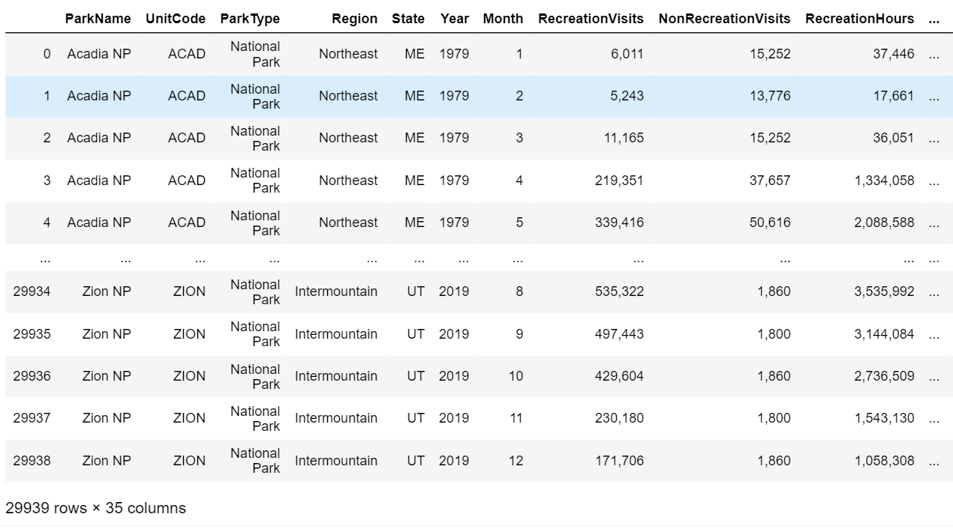
Data Cleaning and Analysis
Data Cleaning
Converted strings to values.
Used join function to combine separate datasets.
Filter unwanted columns
Analysis
Descriptive statistics
Linear regression

Slide 7
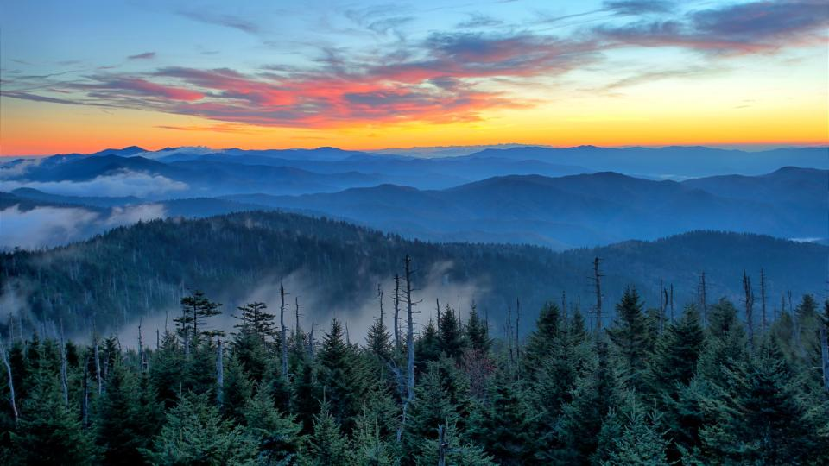
Most Popular Parks
Great Smoky Mountains NP

Slide 8
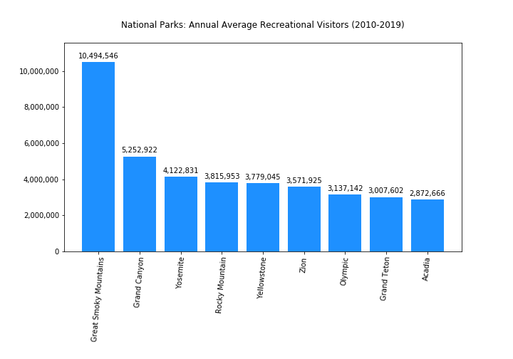

Slide 9
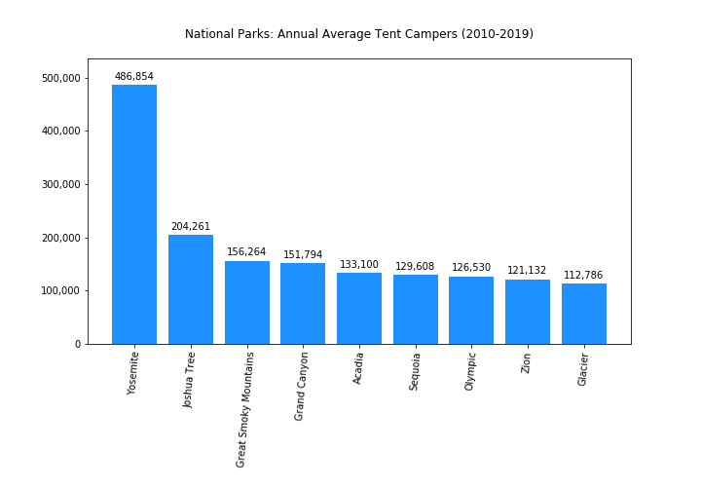

Slide 10
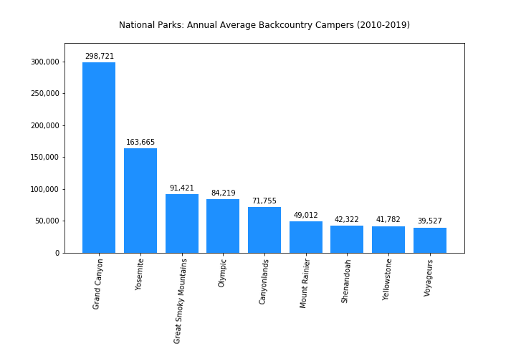

Slide 11
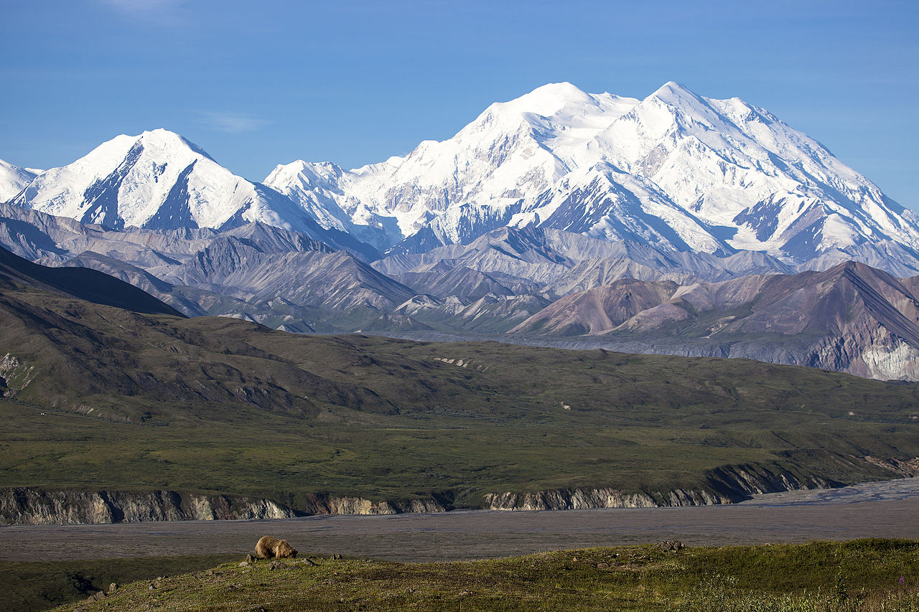
Largest National Parks
Denali NP

Slide 12
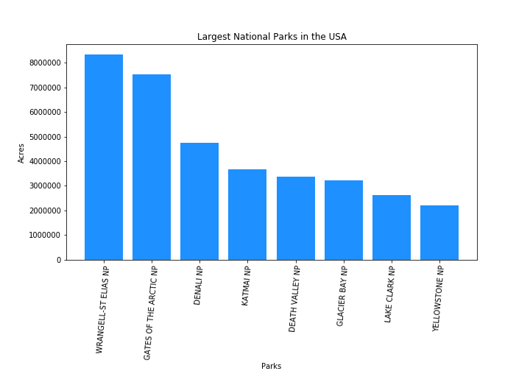

Slide 13
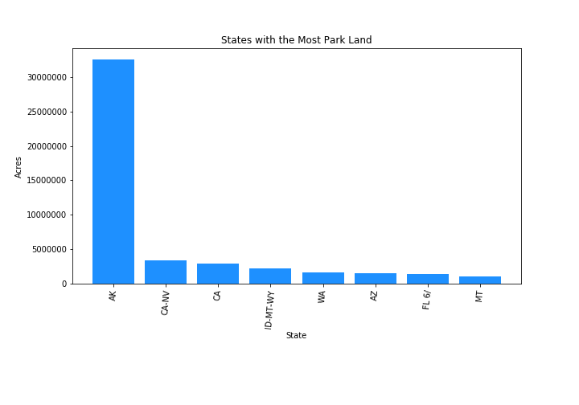

Slide 14
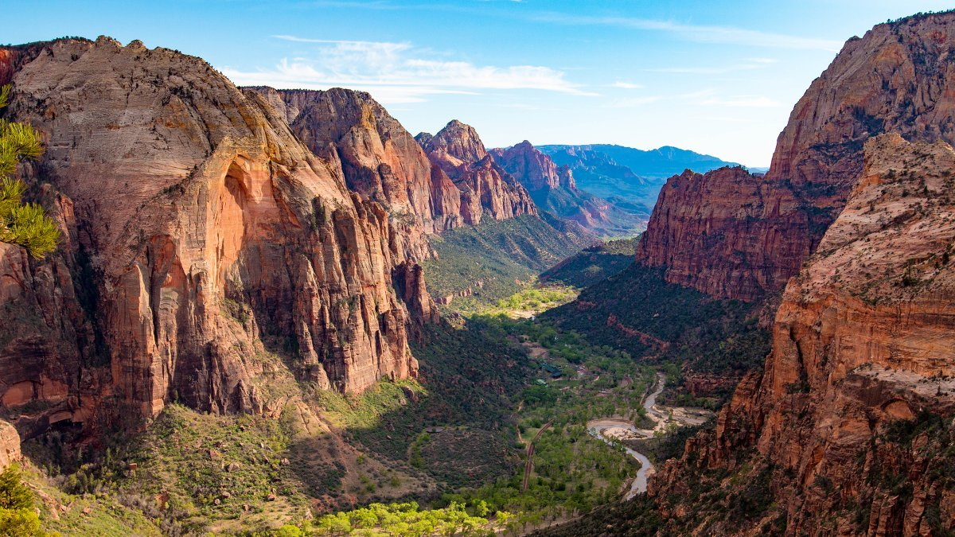
Park Visitation Trends
Zion NP

Slide 15
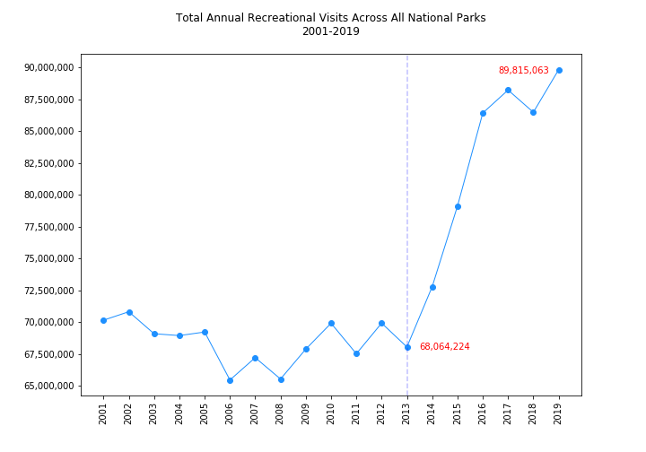

Slide 16
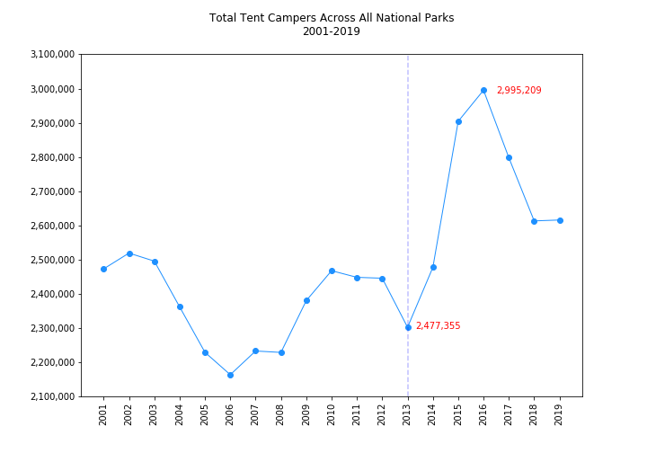

Slide 17
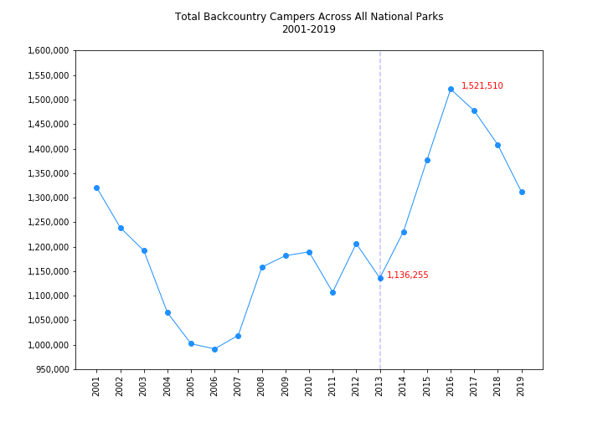

Slide 18
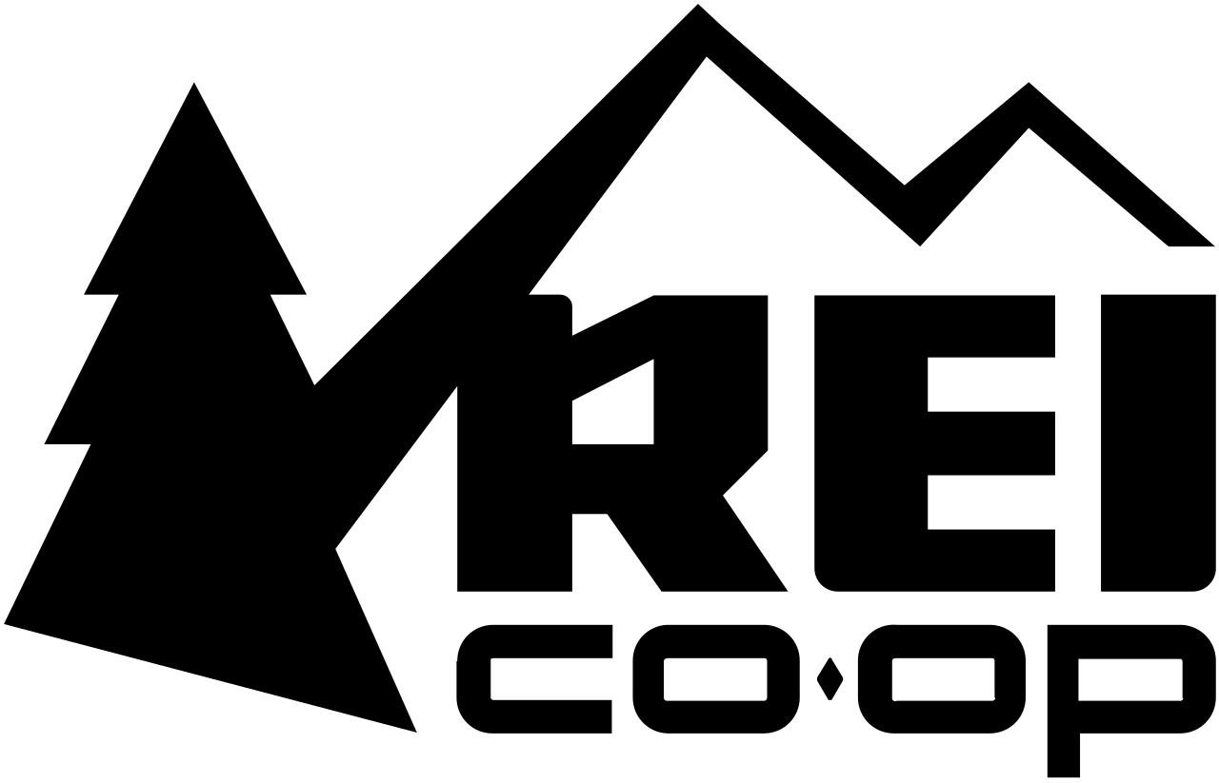
National Park Trends and Outdoor Recreation (REI)

Slide 19
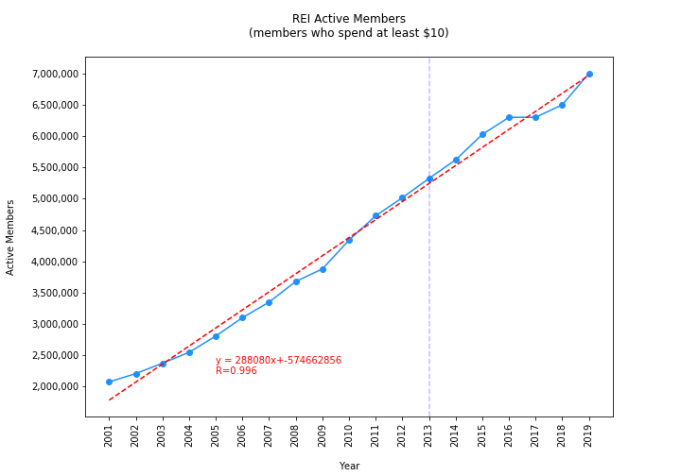

Slide 20
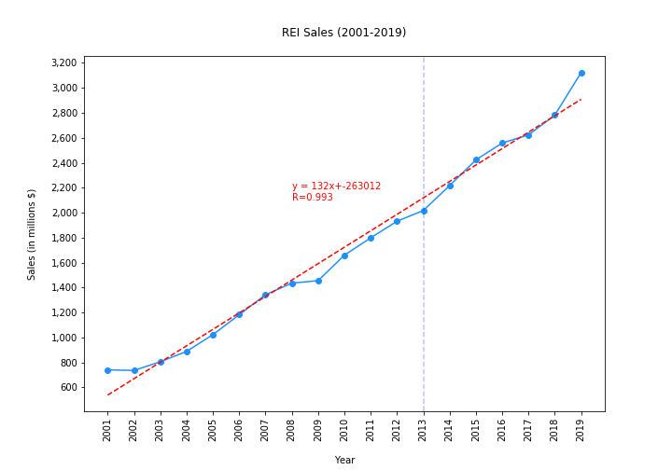

Slide 21
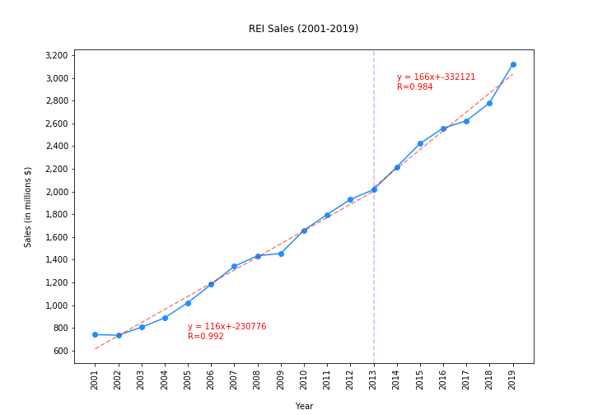

Slide 22
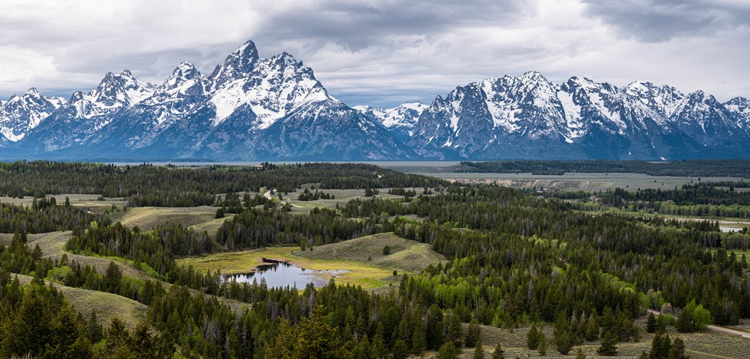
National Parks and Social Media
Grand Teton NP

Slide 23
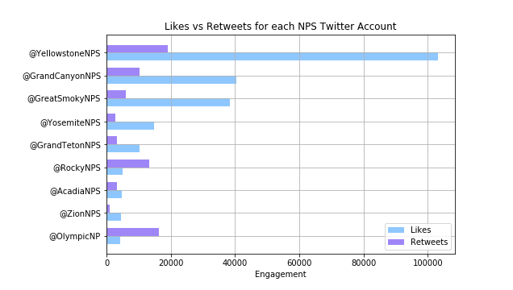
Visitation vs. Engagement

Slide 24
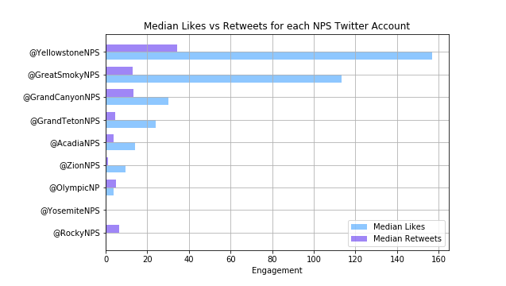
Visitation VS. MEDIAN ENGAGEMENT

Slide 25
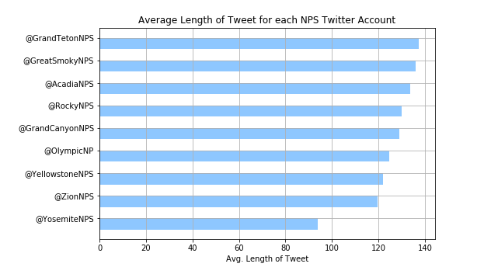
VISITATION VS. tweet length

Slide 26
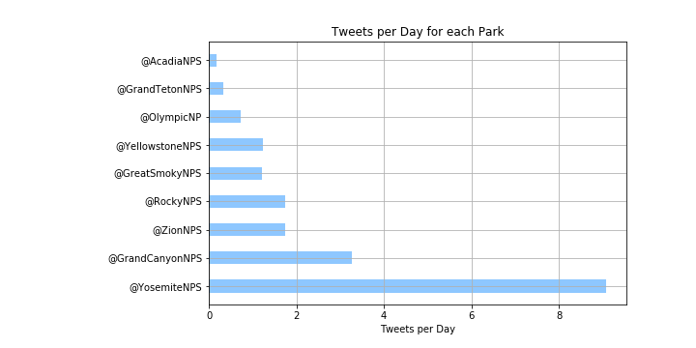
Visitation vs. Engagement

Slide 27
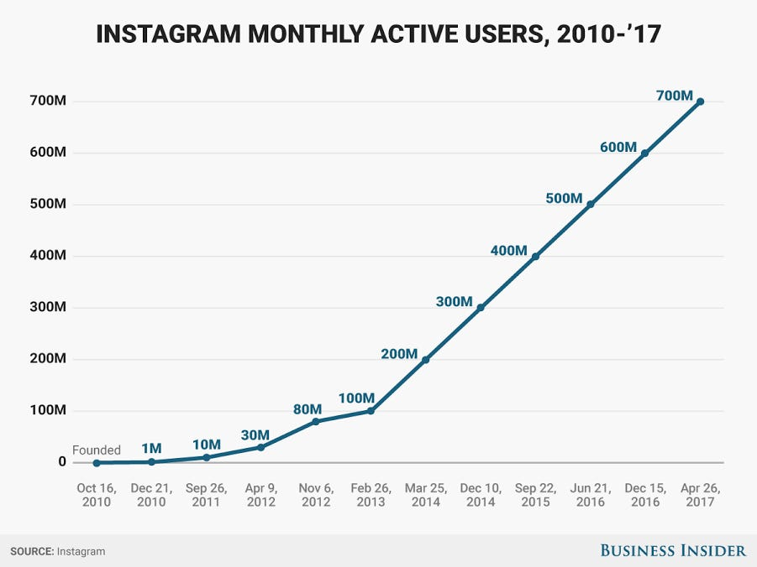
INSTAGRAM

Slide 28
Limitations
Limited historical data from API queries
Twitter only allowed x number of calls per 15-minutes

Slide 29
Conclusions
U.S. National Parks popularity has significantly increased in recent years
Increase in National Parks popularity has influenced the growth of outdoor recreation business
Social Media has impacted National Park popularity

Slide 30
Questions?

